Slide 1

MATH 323
Graph Theory
Cr. 3
Dr. Bhadra Man Tuladhar
MATH 323 Graph Theory Lecture 8

Slide 2
Rooted Tree
d
ℓ
ℓ
c
p
ℓ
ℓ is called leaf
p is parent of c
c is child of p
d is descendent of p
Vertex having same parent is called siblings
N
Root
MATH 323 Graph Theory Lecture 8

Slide 3

Binary Tree
A binary tree is defined as a rooted tree in which there is exactly one vertex of degree two, and each of the remaining vertices is of degree one or three.
Level 0
Level 1
Level 2
Level 3
Level 4
MATH 323 Graph Theory Lecture 8

Slide 4
Properties of Binary Tree
The number of vertices n in a binary tree is always odd.
Let p be the leaves in a binary tree. Then n-p-1 is the number of vertices of degree three.
Number of vertices n = 13
Level 0
Number of vertices of degree 3 = 13-7-1=5
Level 1
Level 2
Level 3
Level 4
MATH 323 Graph Theory Lecture 8

Slide 5

More on Binary Tree
A non-leaf vertex in a tree is called an internal vertex.
In a binary tree vertex v_{i} is said to be at level _{i} if v_{i} is at a distance of _{i} from the root.
A 13-vertex, four-level binary tree.
Level 0
Level 1
Level 2
The number of vertices at levels 1,2,3 and 4 are 2,2,4 and 4 respectively.
Level 3
Level 4
MATH 323 Graph Theory Lecture 8

Slide 6
Exercise
Show that in a binary tree
      p = ½(n+1)
Sketch all binary trees with six leaves. Find the path length of each.
(There are six such trees)
MATH 323 Graph Theory Lecture 8

Slide 7
k-level Binary Tree
There can be only one vertex (the root) at level 0, at most two vertices at level 1, at most four vertices at level 2, and so on. Therefore the maximum number of vertices possible in a k-level binary tree is
2⁰ + 2¹ + 2² + . . . + 2^{k} ≤ n.
MATH 323 Graph Theory Lecture 8

Slide 8
Height of a Binary Tree
The maximum level, _{max} of any vertex in a binary tree is called the height of the tree.
The minimum possible height of an n-vertex binary tree is
min _{max} = [log₂(n+1) - 1],
where [n] denotes the smallest integer greater than or equal to n.
MATH 323 Graph Theory Lecture 8

Slide 9
Height of a Binary Tree
To construct a binary tree for a given n such that the farthest vertex is as far as possible from the root, we must have exactly two vertices at each level, except at the 0 level. Therefore
max _{max} = ½ (n – 1).
MATH 323 Graph Theory Lecture 8

Slide 10
Example
For n = 11, binary trees realizing the extremes are as given below:
Level
Level
max _{max} = ½ (11 – 1)
= 5
0
0
1
1
T₁
T₂
2
2
3
3
4
min _{max} = [log₂ (12) - 1] = 3
5
MATH 323 Graph Theory Lecture 8

Slide 11
The Path Length of a Tree
The path length of a tree is defied as the sum of the path lengths from the root to all leaves.
The path length of T₁ is
3+3+3+3+2+2 = 16.
The path length of T₂ is
1+2+3+4+5+5 = 20.
MATH 323 Graph Theory Lecture 8

Slide 12
Exercise
Sketch all binary trees with 13 vertices.
Find the path length of each of these binary trees.
MATH 323 Graph Theory Lecture 8

Slide 13
Labeled Tree
A graph in which each vertex is assigned a unique name or label is called a labeled tree.
Note:
A
B
A
B
A
B
A
B
C
D
C
D
C
D
C
D
Each of these labeled graphs are different. Some are isomeric if unlabeled.
MATH 323 Graph Theory Lecture 8

Slide 14
Theorem
The number of labeled trees with n vertices (n ≥ 2) is n^{n-2}.
Note:
For n = 4, there are 16 labeled trees.
Exercise:
Draw all these 16 labeled trees.
How many isomerics groups are there if the trees are not labeled?
MATH 323 Graph Theory Lecture 8

Slide 15
Rank and Nullity
Let for a given graph G:
no. of vertices = n
no. of edges = e
no. of components = k. (For k = 1, G is connected)
Rank, r = n – k. (For connected graph, rank = n - 1)
Nullity, μ = e – n + k.
(For connected graph, nullity = e - n + 1)
Rank + nullity = number of edges.
MATH 323 Graph Theory Lecture 8

Slide 16
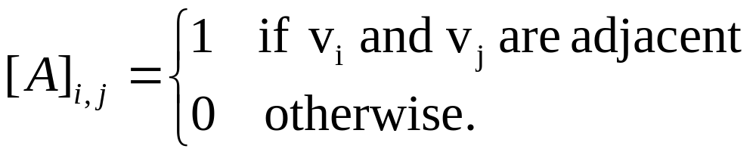
Adjacency Matrix
Let G be a graph with vertices v₁, v₂, . . . , v_{n}.
The adjacency matrix of G is the n×n matrix A whose (i, j) entry, denoted by [A]_{i,j}, is defined by
MATH 323 Graph Theory Lecture 8

Slide 17
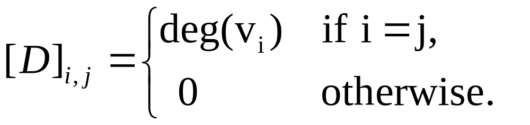
Degree Matrix
Let G be a graph with vertices v₁, v₂, . . . , v_{n}.
The degree matrix of G is the n×n matrix D whose (i, j) entry, denoted by [D]_{i,j}, is defined by
MATH 323 Graph Theory Lecture 8

Slide 18
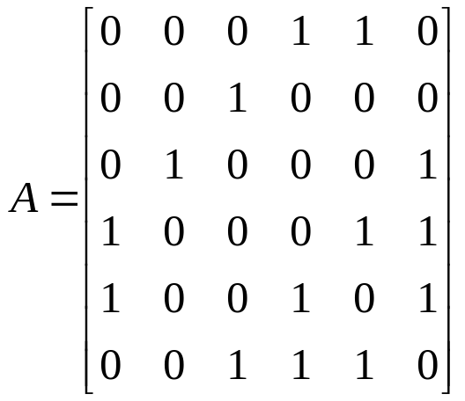
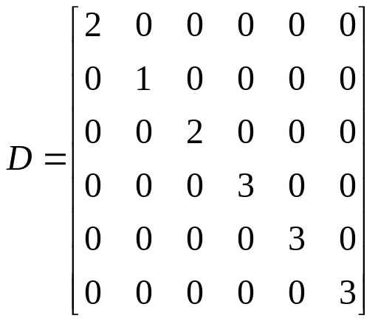
Example
v₁
v₂
Given graph G:
v₆
v₃
v₅
v₄
MATH 323 Graph Theory Lecture 8

Slide 19
Matrix Tree Theorem
If G is a connected labeled graph with adjacency matrix A and degree matrix D, then the number of unique spanning trees of G is equal to the value of any cofactor of the matrix D – A.
MATH 323 Graph Theory Lecture 8

Slide 20
Example
v₁
v₂
Given labeled Graph G:
The number of spanning trees = 8.
Exercise!
v₃
v₄
MATH 323 Graph Theory Lecture 8

Slide 21
Exercise
Draw a digraph with vertices V = {v₁, v₂, v₃, v₄, v₅} and edges E = {(v₁,v₃),(v₁,v₄), (v₄,v₁),(v₁,v₂),(v₂,v₂),(v₄,v₃),(v₅,v₄),(v₅,v₃), (v₅,v₃),(v₅,v₃)}.
Draw the digraph of the relation R defined by “x divides y” on V = {2,3,4,6,9}.
MATH 323 Graph Theory Lecture 8

Slide 22
Digraphs
Definition. A digraph (or a directed graph) D (V_{D};E_{D}) consists of the vertices set V_{D} and (directed) edges set E_{D}.
Digraphs has many physical applications:
  _{One-way traffic}
  _{Electrical networks}
  _{Computer programming}
  _{Control theory}
MATH 323 Graph Theory Lecture 8

Slide 23
Digraphs
Most of the concepts and terminology of undirected graphs are also applicable to digraphs.
A digraph is also referred to as an oriented graph.
In a digraph an edge is incident out of a vertex and incident into a vertex.
MATH 323 Graph Theory Lecture 8

Slide 24
Some Definitions
The number of edges incident out of a vertex v_{i} is called the out-degree and denoted by d⁺(v_{i}).
The number of edges incident into a vertex v_{i} is called the in-degree and denoted by d⁻(v_{i}).
MATH 323 Graph Theory Lecture 8

Slide 25
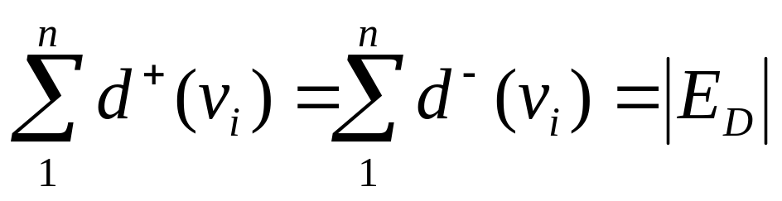
Handshaking Lemma
Let D be a digraph. Then
MATH 323 Graph Theory Lecture 8

Slide 26
Some Types of Digraphs
A digraph that has no loop or parallel edges is called a simple digraph.
Digraphs that have at most one directed edge between a pair of vertices, but are allowed to have loops, are called asymmetric.
Digraphs in which for every edge (a,b) there is also an edge (b,a) are called symmetric digraphs.
MATH 323 Graph Theory Lecture 8

Slide 27
Complete Digraphs
A complete symmetric digraph is a simple digraph in which there is exactly one edge directed from every vertex to every other vertex.
A complete symmetric digraph of n vertices contains n(n-1) edges.
MATH 323 Graph Theory Lecture 8

Slide 28
Complete Digraphs
A complete asymmetric digraph is an asymmetric digraph in which there is exactly one edge between every pair of vertices.
A complete asymmetric digraph is also called a tournament.
A complete asymmetric digraph of n vertices contains n(n-1)/2 edges.
MATH 323 Graph Theory Lecture 8

Slide 29
Digraphs and Binary Relations
A digraph is the most natural way of representing a binary relation on a set V.
Every binary relation on a finite set can be represented by a digraph without parallel edges.
Every digraph without parallel edges defines a binary relation on the set of its vertices.
MATH 323 Graph Theory Lecture 8

Slide 30
Example
Digraph of a Binary relation
This digraph represents the relation “greater than” on a set of five numbers {3, 4, 5, 7, 8}.
4
5
7
3
8
The binary relation R = {(8,7),(8,5),(8,4),(8,3),(7,5),(7,4),(7,3),(5,4),(5,3),(4,3)}
MATH 323 Graph Theory Lecture 8

Slide 31
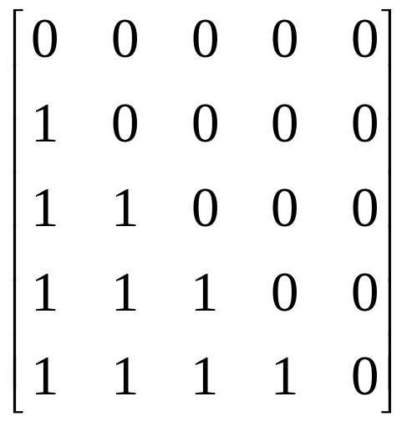
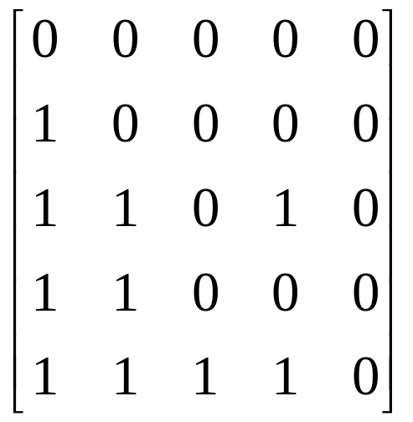
Relation Matrix
Digraph can also be represented by a relation matrix.
On set {3, 4, 5, 7, 8}
On set {3, 4, 7, 5, 8}
MATH 323 Graph Theory Lecture 8

Slide 32
More Next Time
MATH 323 Graph Theory Lecture 8

